Slide 1

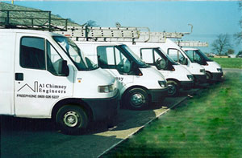
Report Samples

Slide 2
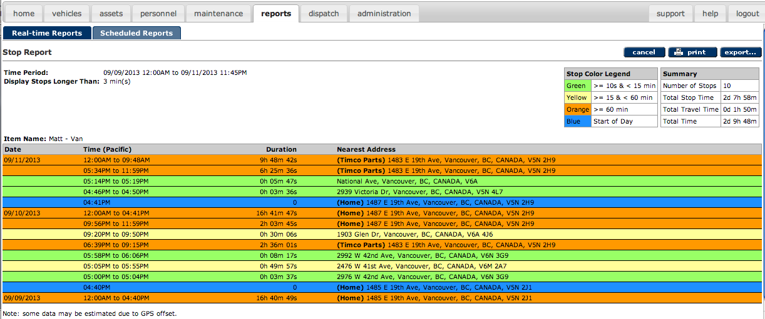
Stop Report
Shows where, when and for how long a vehicle has stopped.

Slide 3
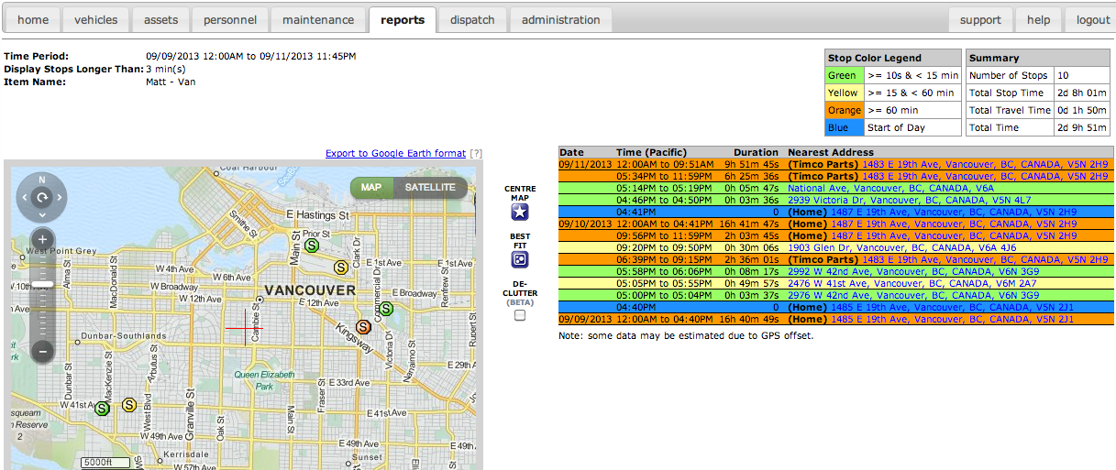
Stop Report with Map
Shows where, when and for how long an item has stopped with an interactive map.

Slide 4
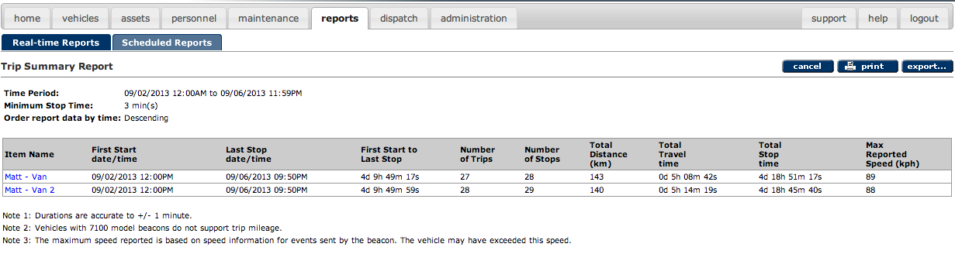
Trip Report Summary
Provides summary trip and stop data for one or more items…

Slide 5
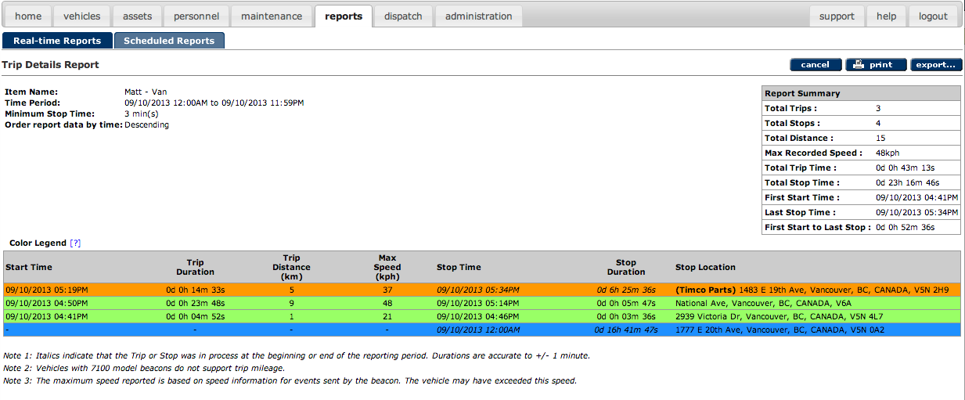
Trip Report Detail
…plus a detail view by item.

Slide 6
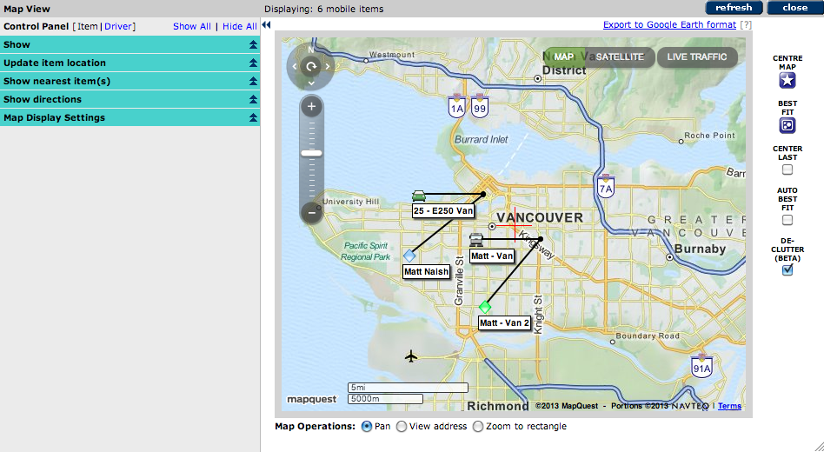
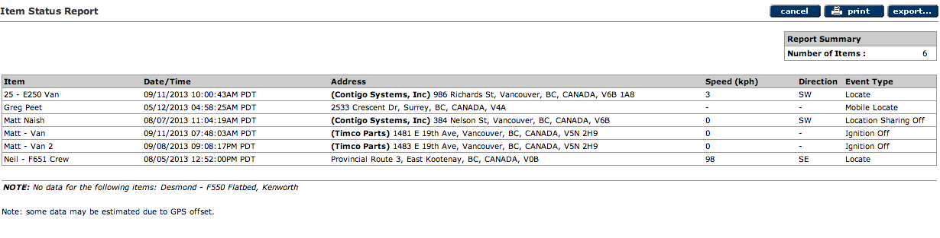
Status Reports
Provides a quick snapshot of an entire fleet.

Slide 7
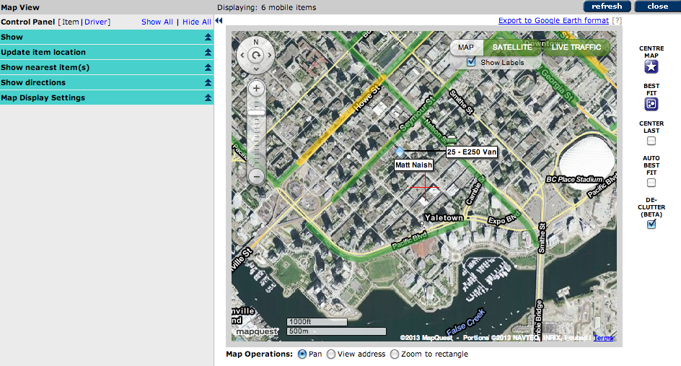
Map View
View vehicles on street or satellite maps with real-time traffic.

Slide 8
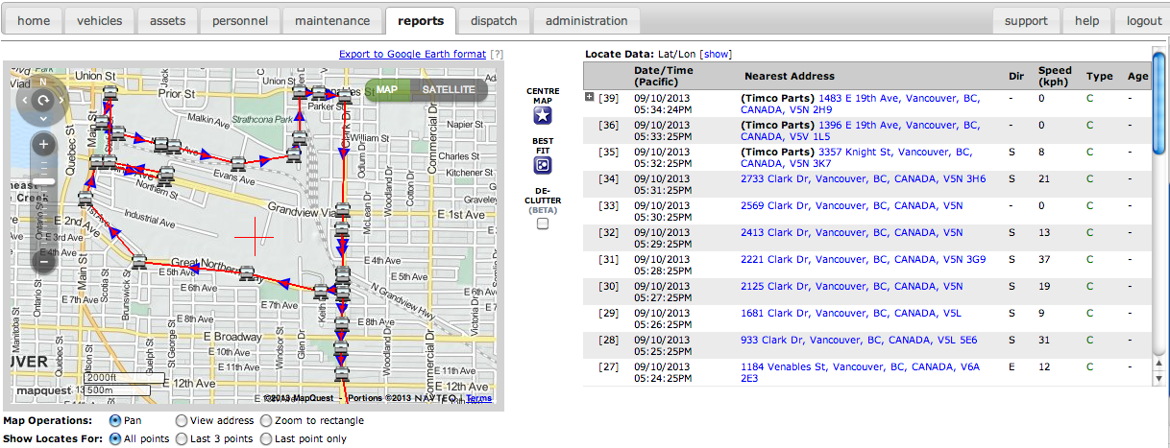
Route log
Shows an item’s route for a selected time period with address data, and a map view.

Slide 9
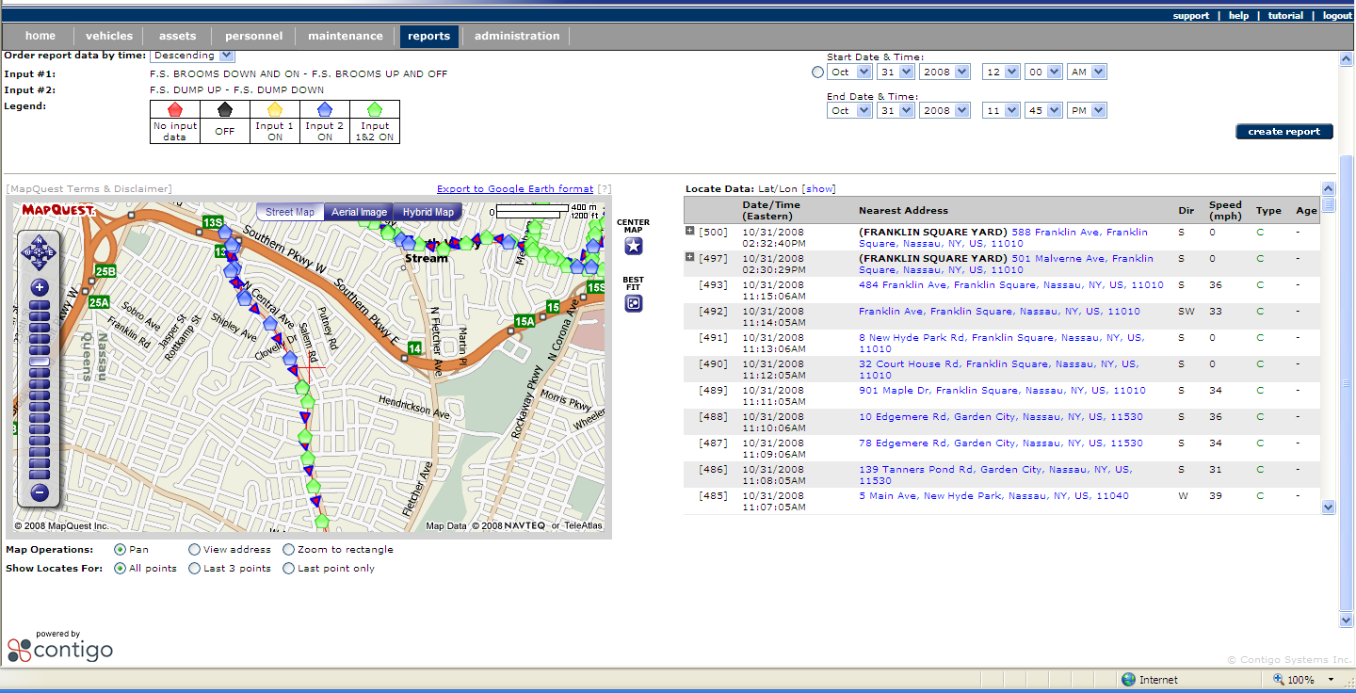
Route log – with Sensors
Shows where PTOs and vehicle sensors were activated and deactivated.

Slide 10
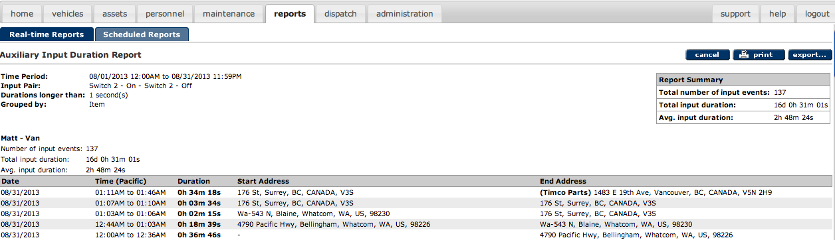
Auxiliary Input Duration
Shows when, where and for how long PTOs and vehicle sensors were used.

Slide 11
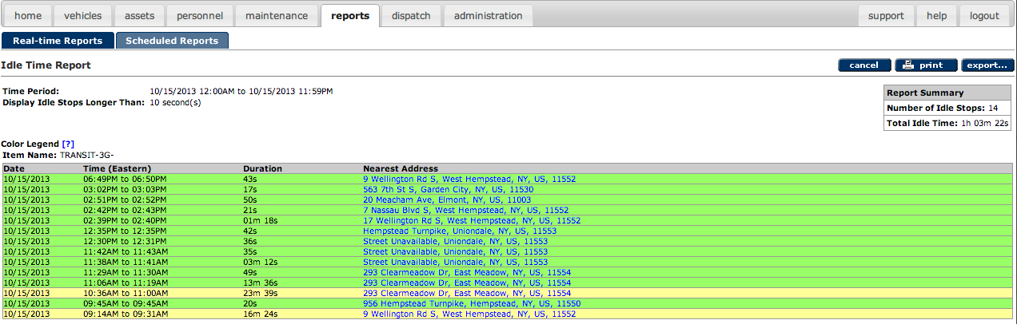
Idle Time Report
Calculates the total engine idle time for one or more items for a selected time range.

Slide 12
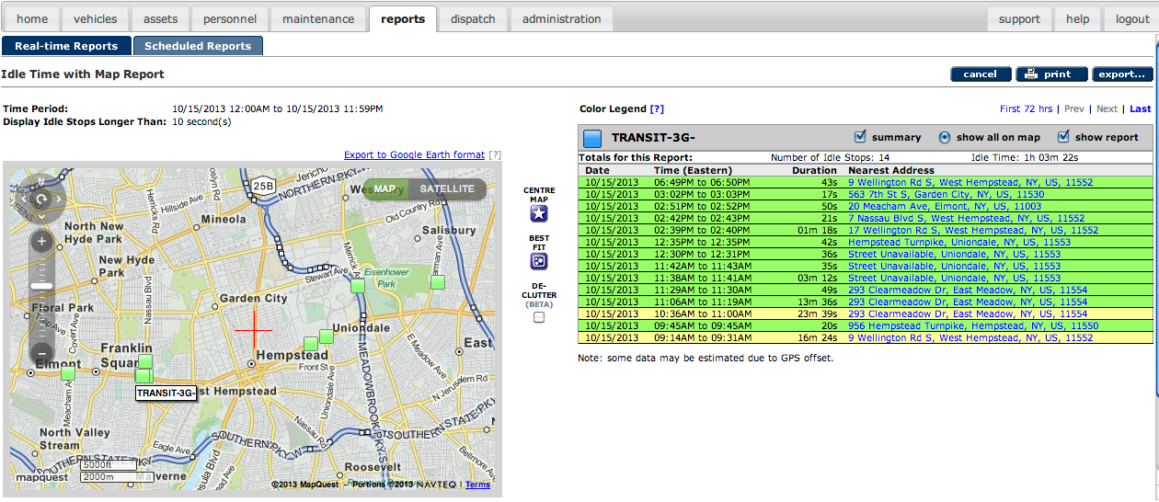
Idle Time Report – with Map
Calculates the total engine idle time for one or more items for a selected time range, shown on an interactive map.

Slide 13
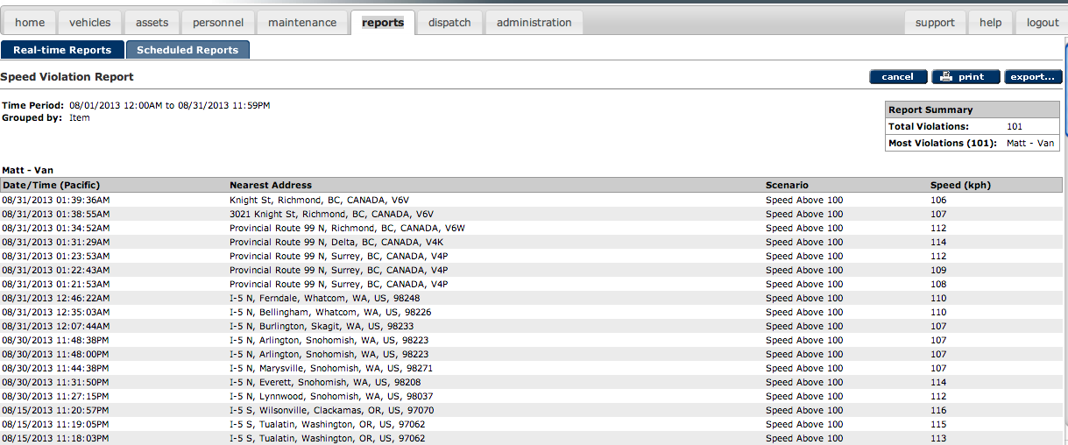
Speed Violation
Shows a summary of speed violations for selected vehicles for a selected time range.

Slide 14
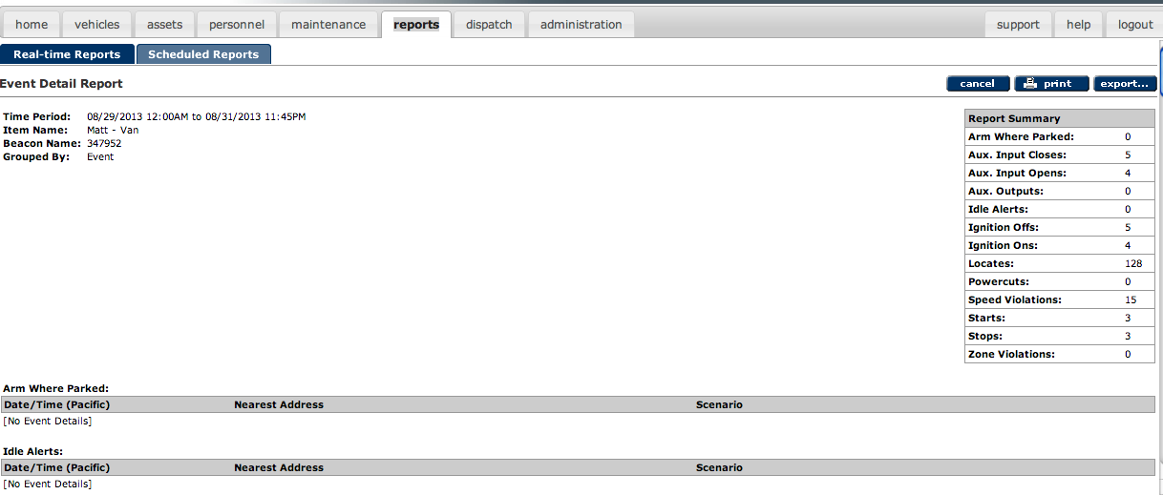
Event Detail (page 1 of 3)
Provides a detail view for one or more events for selected items, for a selected time period.

Slide 15
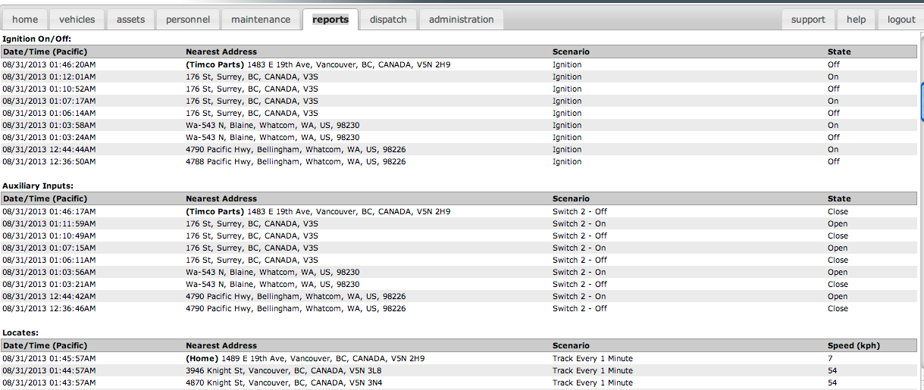
Event Detail (page 2 of 3)

Slide 16
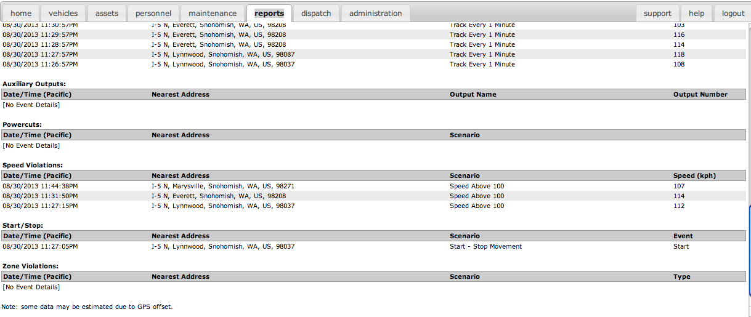
Event Detail (page 3 of 3)

Slide 17
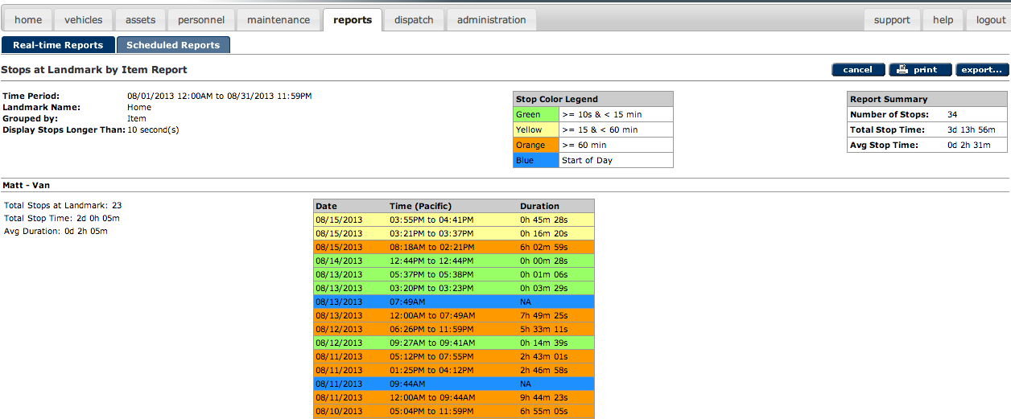
Landmarks
Shows when and for how long item(s) have stopped at a selected Landmark.

Slide 18
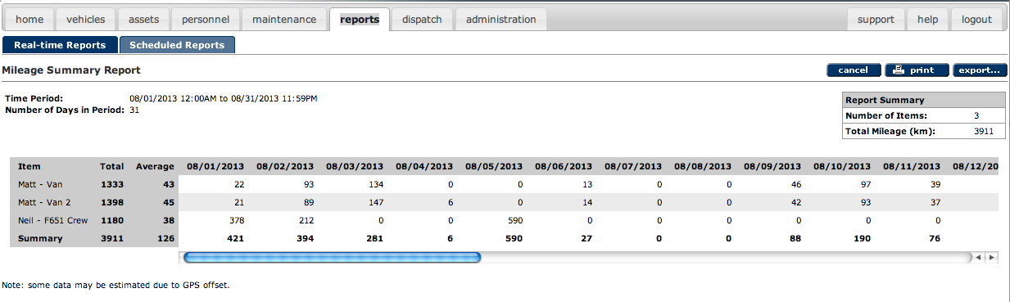
Mileage Summary
Provides a summary, by item, of the total distance traveled for all items.

Slide 19
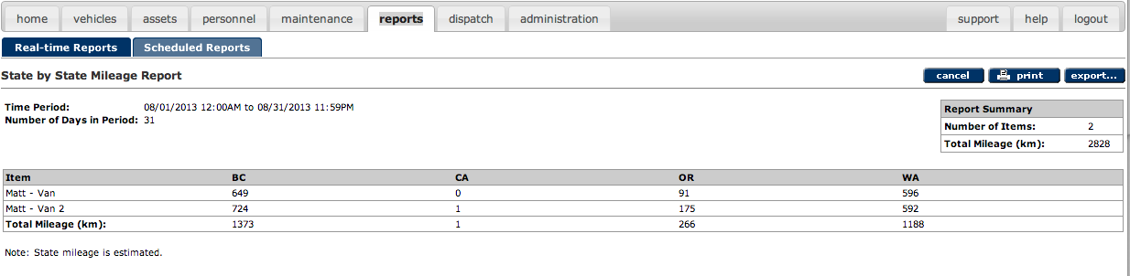
State by State Mileage
Provides an itemized summary of the distance traveled for each item by state.

Slide 20
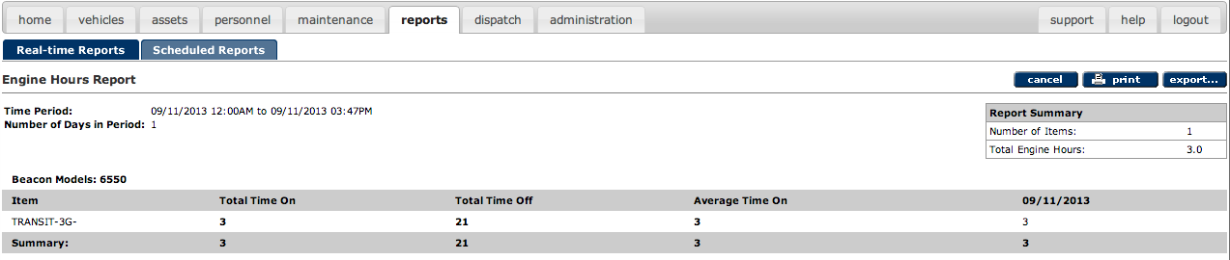
Engine Hours
Calculates the engine running time for selected items for the selected time period.

Slide 21
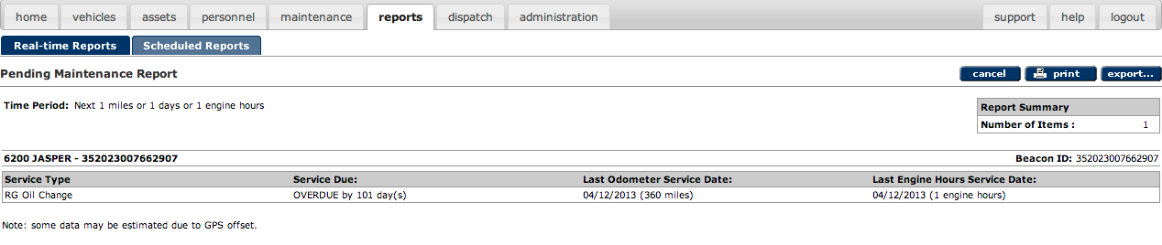
Pending Maintenance
Show maintenance items due in the next service interval (measured in mileage or days).

Slide 22
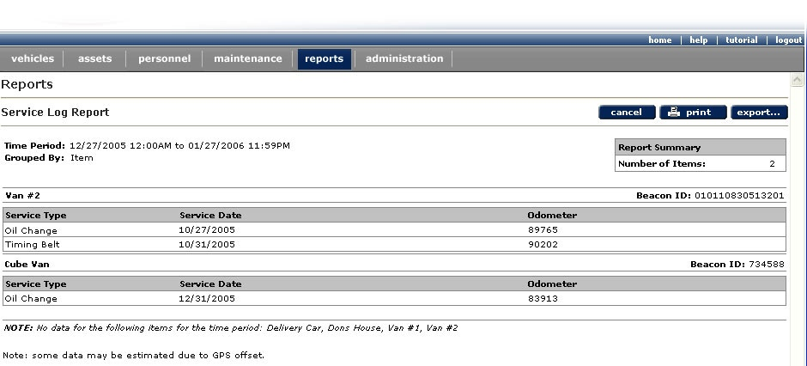
Service Log
Provides a detail view for one or more service logs for selected items, for a selected time period.

Slide 23
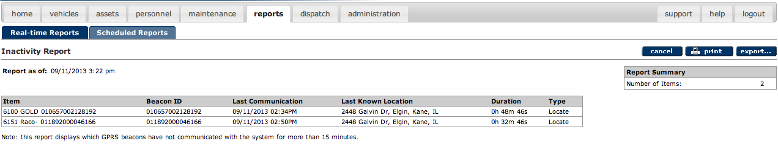
Inactivity Report
Helps determine which beacons have not communicated with the system recently.

Slide 24
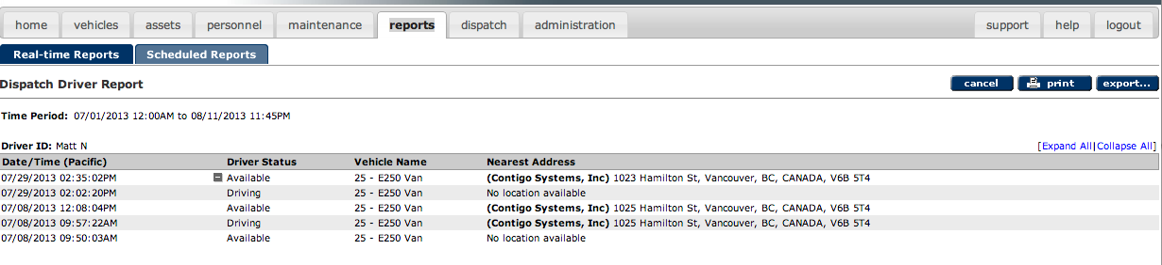
Dispatch Driver Report
Provides a detailed view of status changes by driver.

Slide 25
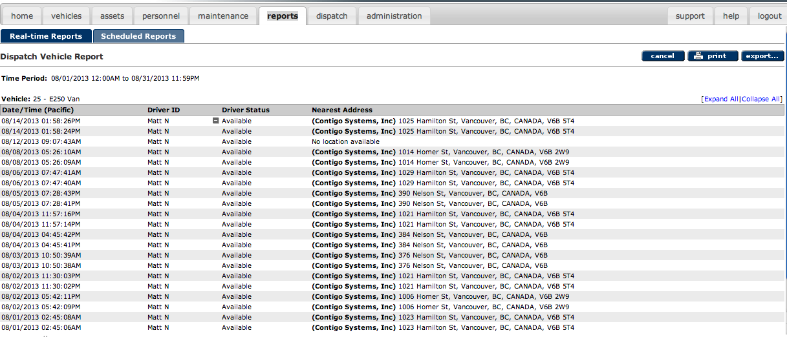
Dispatch Vehicle Report
Provides a detailed view of status changes by vehicle.

Slide 26
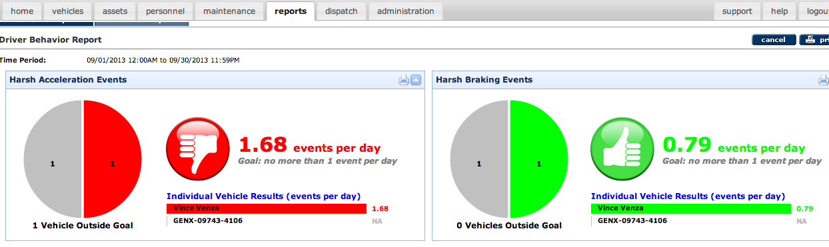
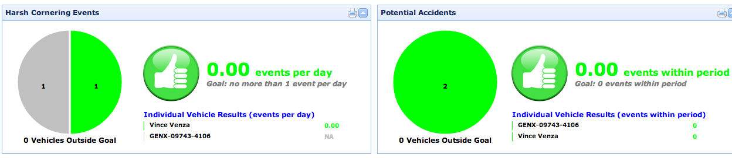
Driver Behavior

Slide 27
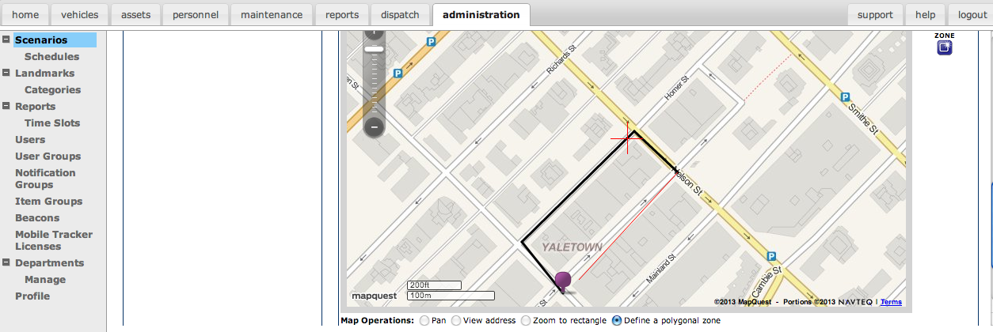
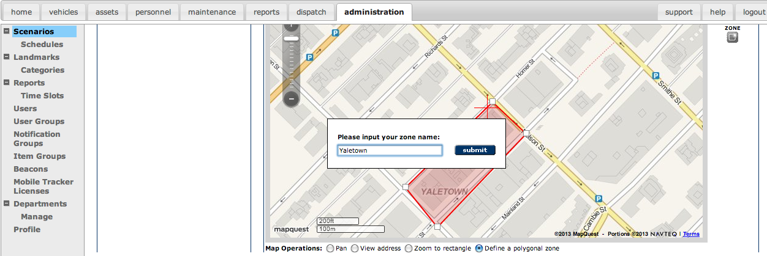
Speed Within a Zone

