Slide 1
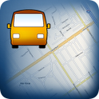
Mobile Tracker

Slide 2
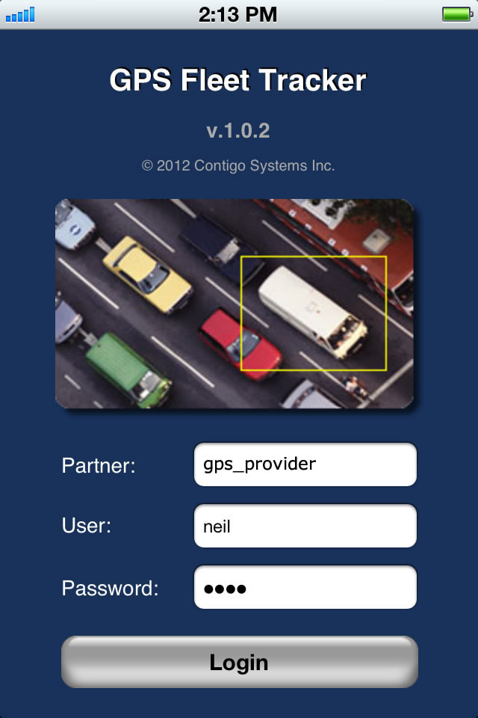
Mobile Tracker
Low cost location sharing from iPhone and Android
Embedded feature within GPS Fleet Tracker App
Integrated with existing Contigo portal
Simple solution, low impact to employees

Slide 3
Mobile Tracker
For employers who wish to locate their employees during the workday for safety and productivity, but who cannot install a tracking device in the employee’s vehicle, Mobile Tracker provides 1 to 10 minute location updates from a simple iPhone / Android App.
Unlike alternative solutions, Mobile Tracker minimizes impact on the employee’s battery life, leverages the phone’s existing data plan, and doesn’t require the employee to manually check-in.

Slide 4
Benefits
Integrated with Contigo’s GPS Fleet Tracker application
Most popular iPhone and Android handsets / tablets supported
One web interface - Both vehicles and personnel are visible in the same web portal and reports
Battery-optimized - minimize impact on employee productivity
Control – managers can administrate which employees may be tracked, and who has rights to view those locations
Protects employee privacy - allows them to disable tracking while on personal time
Single smartphone/tablet interface – the GPS Fleet Tracker app can be utilized to share locations, and to view the locations of colleagues and fleet vehicles
No new data plan – leverages the phone/tablet’s existing web/email data plan

Slide 5
How it works
Employees download and install Contigo’s GPS Fleet Tracker
User is prompted if they want to share their location
User can adjust reporting frequency from 1 to 10 minutes

Slide 6
Employees are in control
Satisfy employee privacy concerns
Users choose whether or not to share when the app launches
Users can disable sharing, or logout of the application, when they are off-duty, hiding their location from the server

Slide 7
Simple view for employees
Employees see their own location on the GPS Fleet Tracker Map
Can continue to see vehicles / employees in the same map
User privileges define which vehicles they can see

Slide 8
Simple dashboard view for managers
Both fleet vehicles and phone users appear in the same mapping interface and reports

Slide 9
Easy setup
Employers create user accounts with Mobile Tracker privilege
Employees login from GPS Fleet Tracker, and are prompted if they want to share their location

