Slide 1
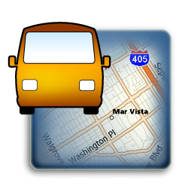
Driver Identification
January 2014
- Company Confidential -

Slide 2
Driver Identification – Why?
Enhance accountability by looking up which vehicle was driven by which driver at a particular time.
Increase fleet awareness by seeing full real-time location of a driver regardless of which vehicle they are driving.
Save time by viewing driver-centric historical reports. No need to cross reference with other driving logs.

Slide 3

Driver Identification – How?
The latest Contigo beacons include support for a connection to a touch-and-go iButton reader, which allows drivers to identify themselves at the beginning of trips.

Slide 4
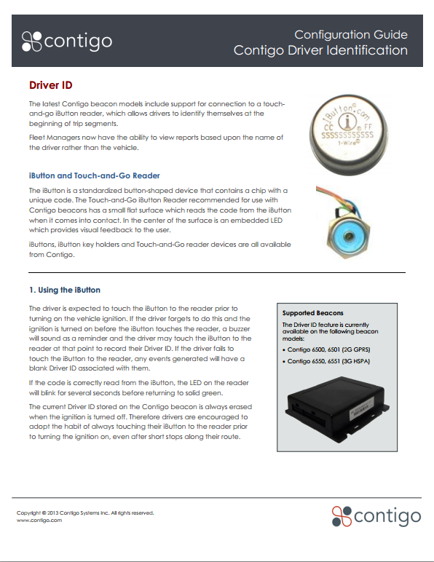
Learn More
Contigo Driver ID
Configuration Guide

Slide 5

Contact Information
Matt Naish Vice President, Sales mnaish@contigo.com 604.683.3106 ext 240
Corporate Headquarters 280 Nelson Street, Suite 498 Vancouver, BC V6B 2E2
www.contigo.com

