Slide 1
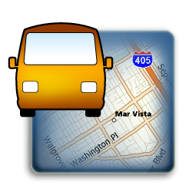
Driver Behavior Modification
December 2013
- Company Confidential -

Slide 2
Driver Behavior Modification – Why?
Reduce risk & increase safety by monitoring & changing driving behavior.
Minimize maintenance costs associated with improper use of fleet vehicles.
Protect business reputation by proactively modifying driving habits.

Slide 3
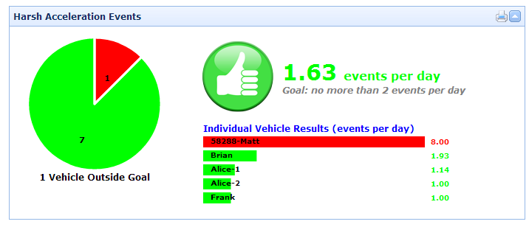
Driver Behavior Modification – How?
Receive in-cab alerts and web-based performance reports on driving behavior:
  Harsh Acceleration, Braking, Cornering
  Potential Accident

Slide 4
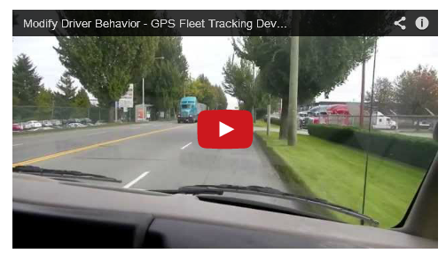
Driver Behavior Modification – How?
http://www.youtube.com/watch?v=KdDu-QByzYw

Slide 5
Return on Investment
According to recent comparisons¹, better driver habits results in 42% less total maintenance costs and 54% less brake and tire repair costs.
Driving behavior feedback can result in an average estimated accident reduction of 20%².
¹Donlen, a Hertz company, 2013; ²SWOV Institute for Road Safety Research, 2000

Slide 6
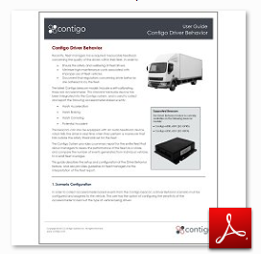
Learn More
Contigo Driver Behavior
User Guide

Slide 7

Contact Information
Matt Naish Vice President, Sales mnaish@contigo.com 604.683.3106 ext 240
Corporate Headquarters 280 Nelson Street, Suite 498 Vancouver, BC V6B 2E2
www.contigo.com

